Slide 1
Vacuum Oven Pre-Maintenance Solution 真空炉 预测性维护方案
T RDA IOT INW
Dec., 2021

Slide 2
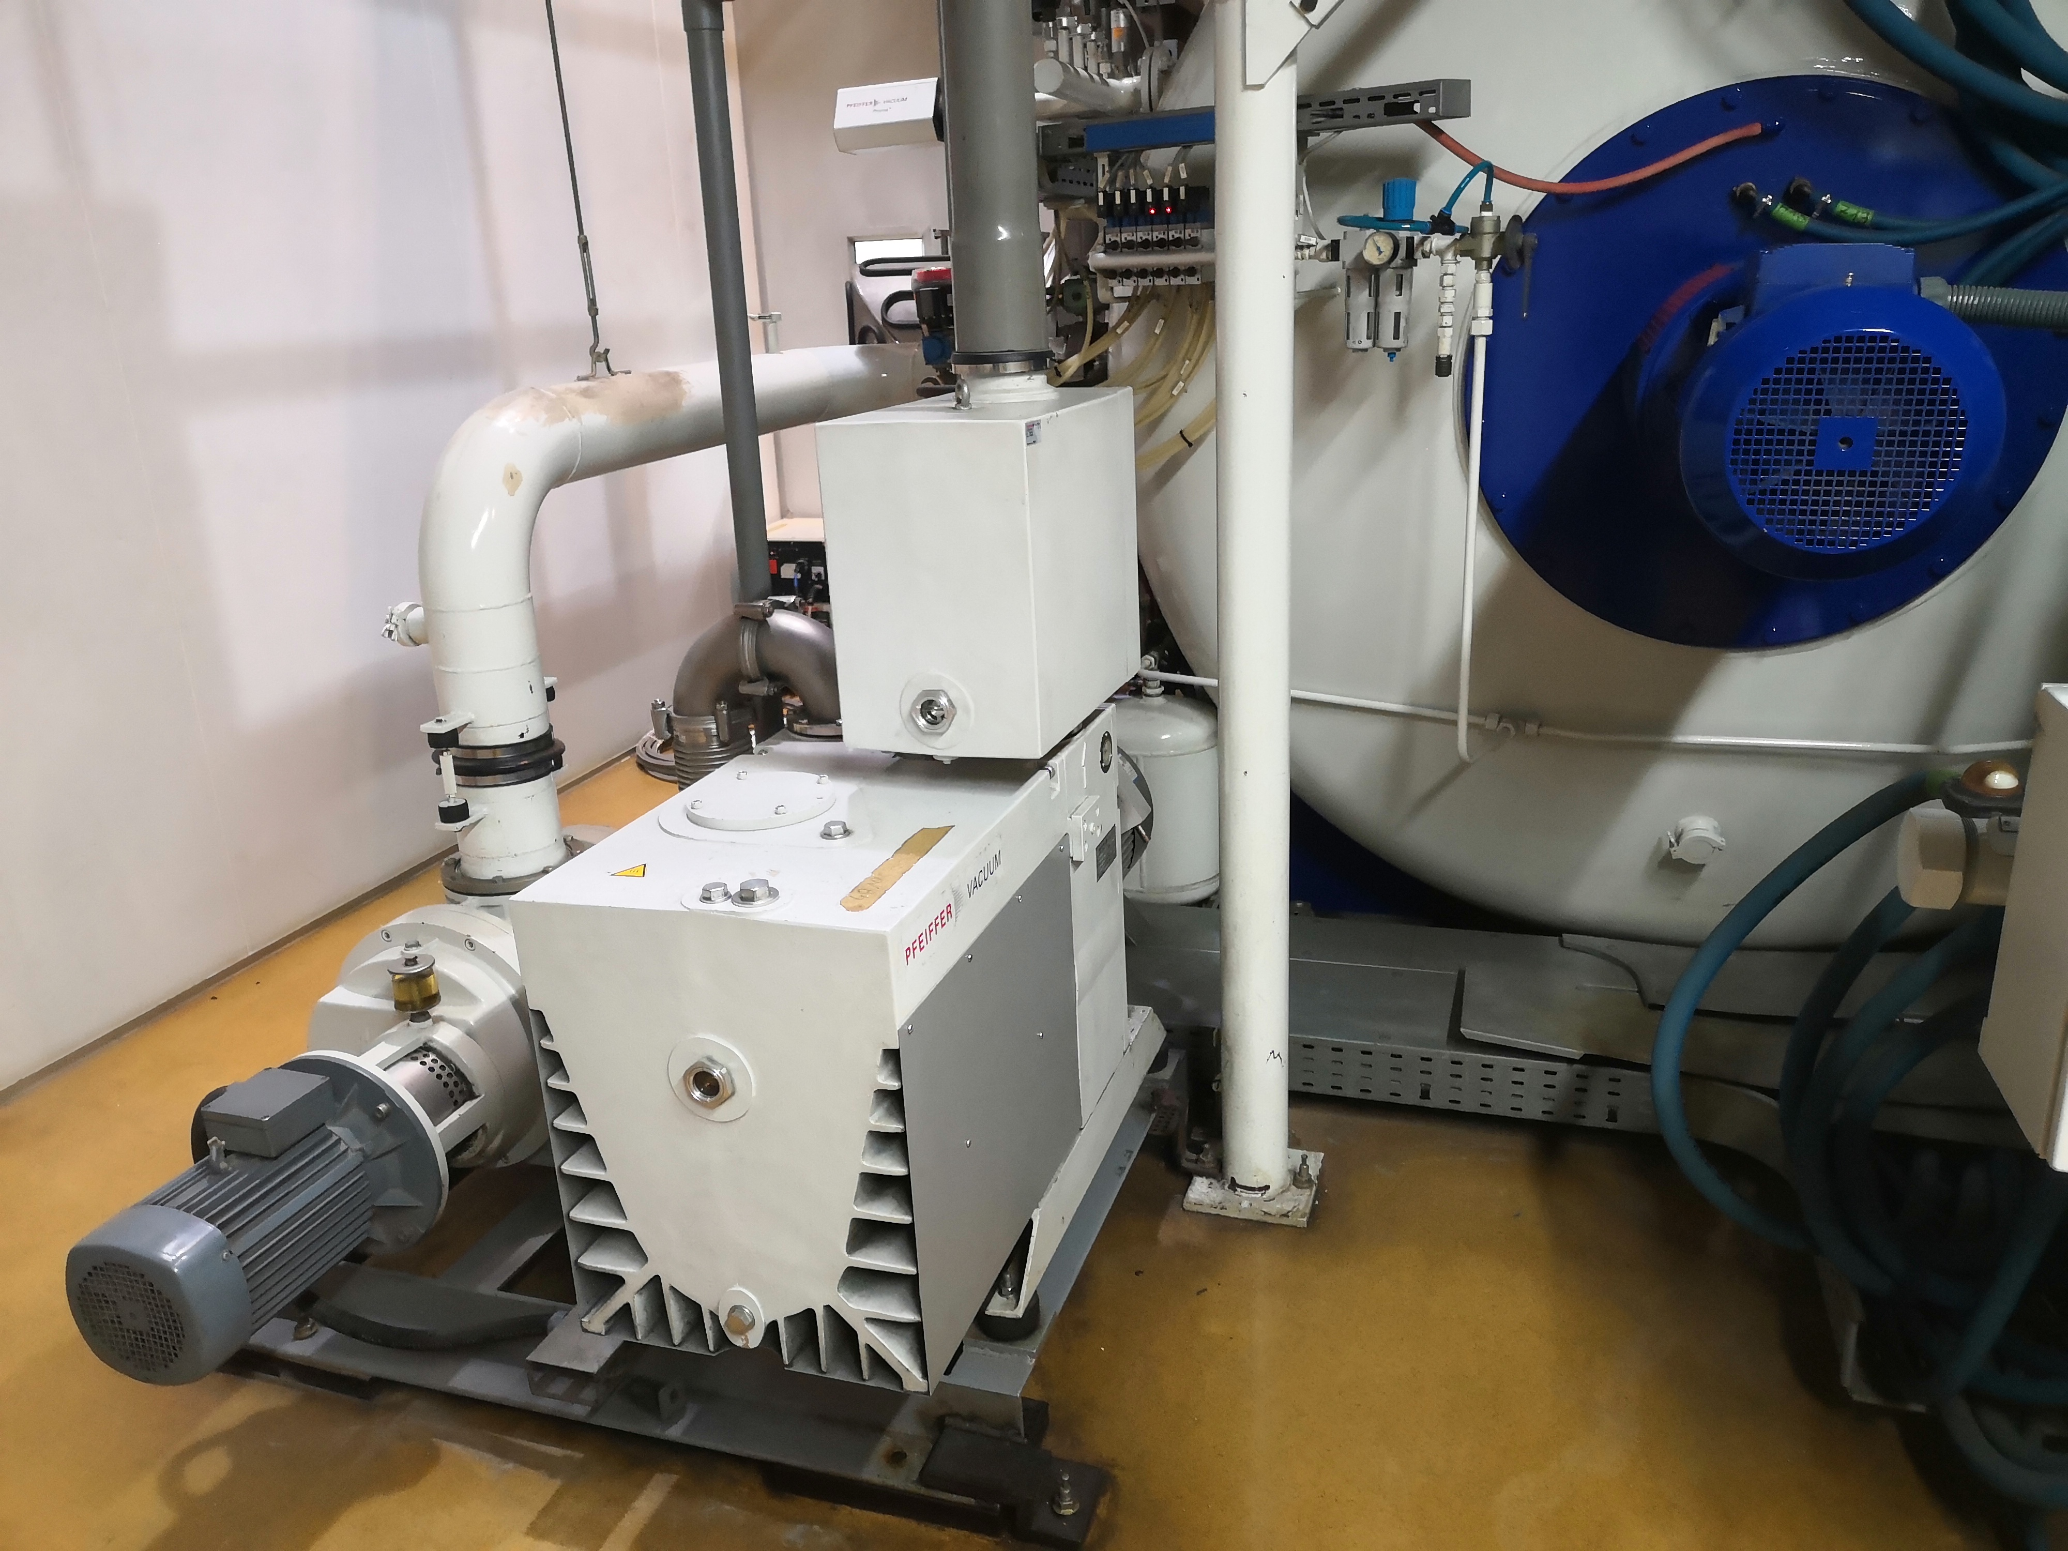
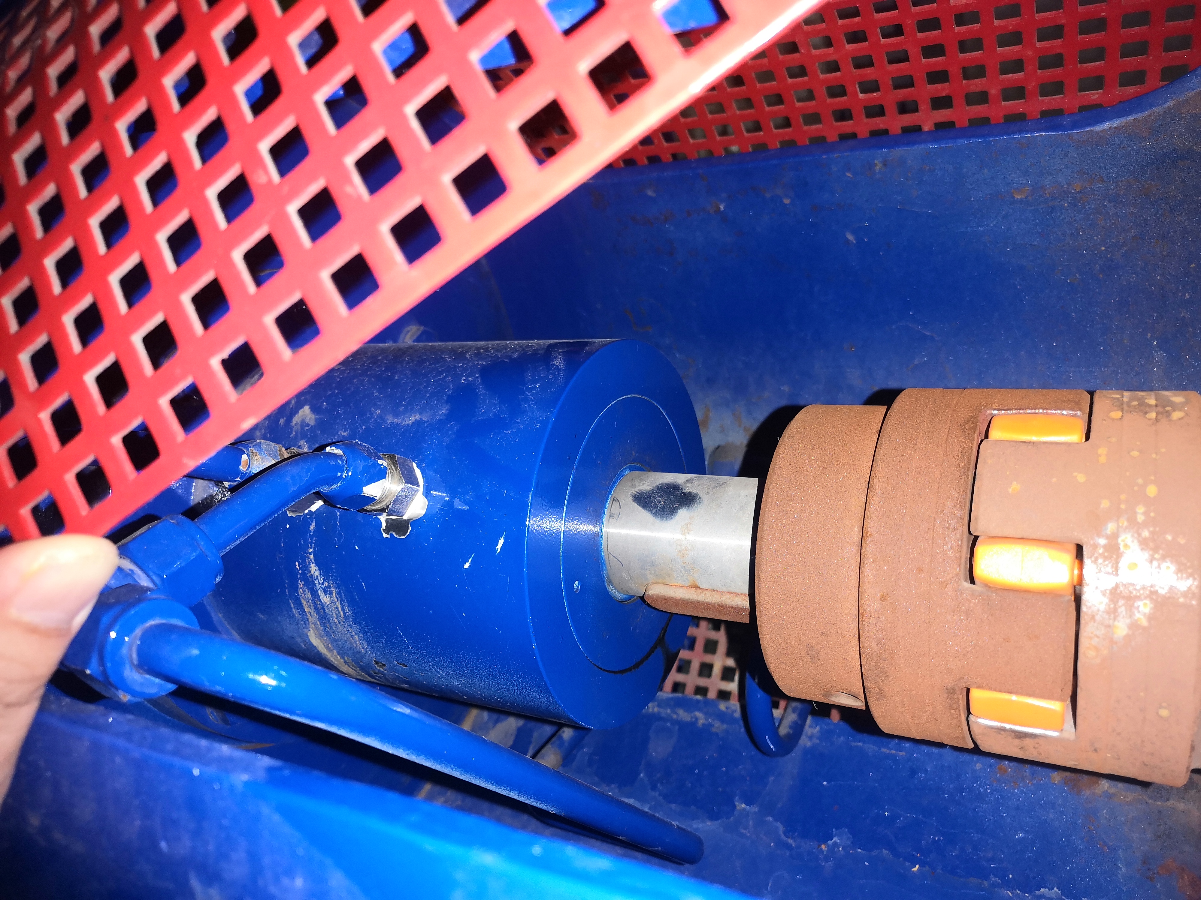
Investigation on Vacuum Oven 真空炉设备调研
Importance 重要性
- Vacuum Oven is the core device in the production process.
真空炉是生产过程中的核心设备
- Vacuum Oven failure and production quality problems have great economic impact on the factory.
真空炉故障和生产质量对工厂有较大的经济影响
Maintenance Challenge 设备维护挑战
- Expensive spare parts, avoid excessive maintenance and save spare cost. （e.g. the failure of Magnetic Fluid varies from 1 year to22 years, it is difficult to estimate the replacement time of magnetic fluid.）
备件较昂贵，需避免过度维护，以节省备件成本(例如磁流体因故障更换的生命时长有1年到22年不等，很难估计备件定期更换时间)
- Difficult to determine the root cause of the failure, because there are many parts and influencing factors.
因真空炉属于大型关键设备，由多部件组成，影响因素较多，故而较难确认设备的故障原因
Oven Body and Mechanical Pump
炉体和机械泵
Magnetic Fluid
磁流体
Restricted | © Siemens 2021 | T RDA IOT INW-CN

Slide 3
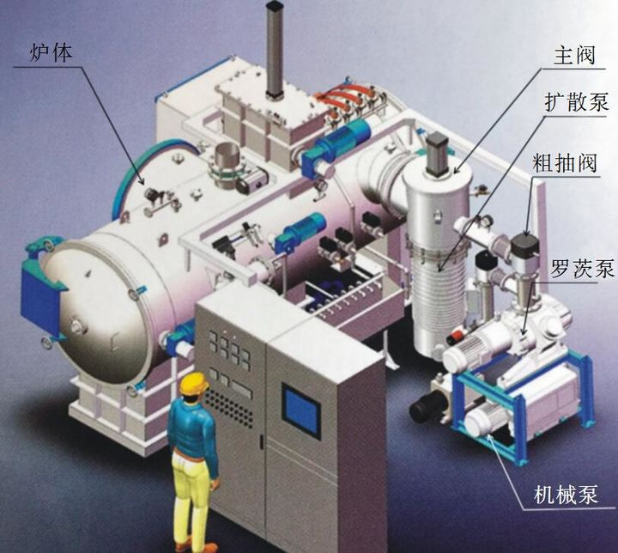
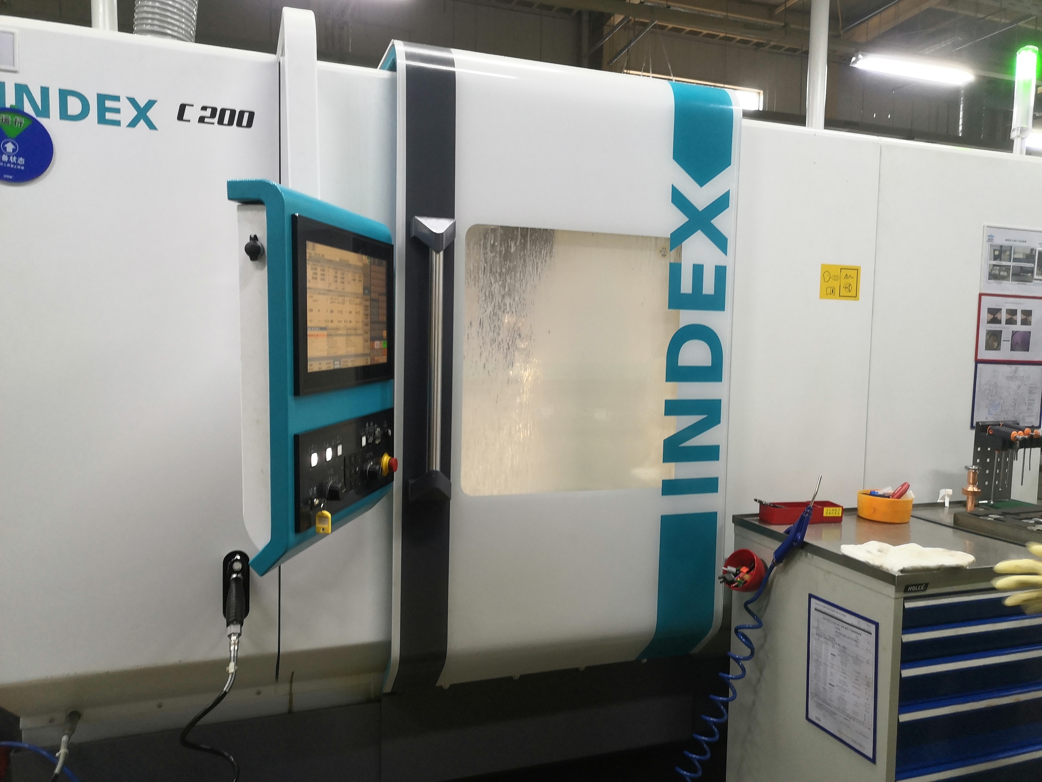
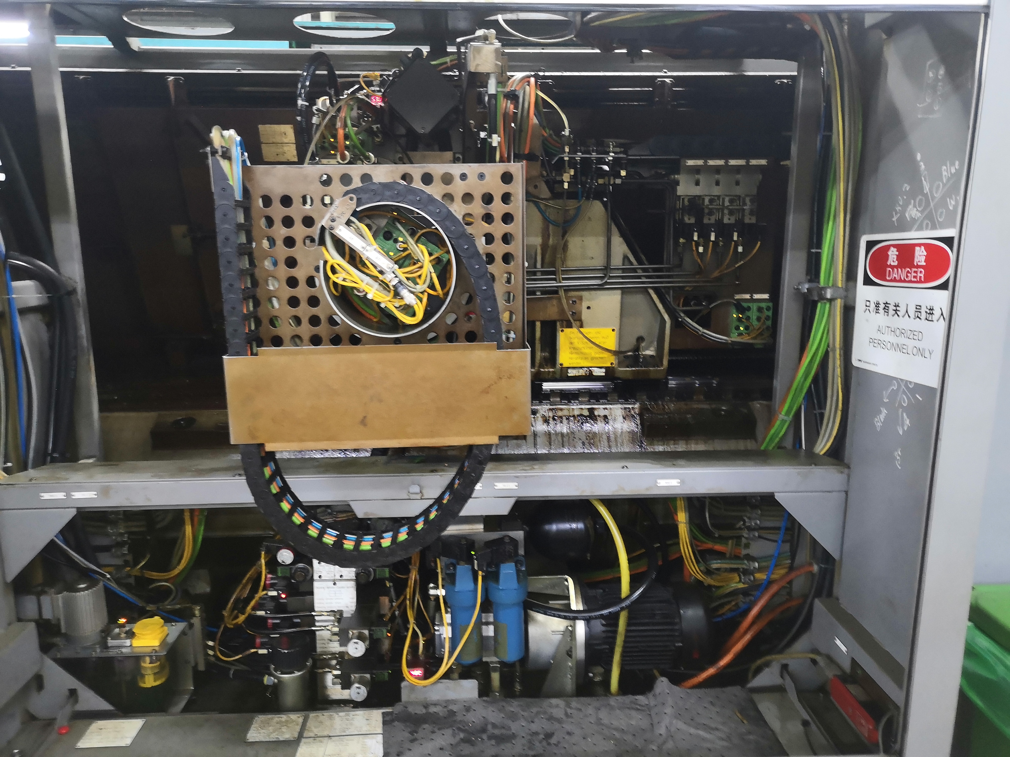
Phased Advance of Vacuum Oven Pre-maintenance Services 分阶段推进真空炉预维护服务
Build the architecture of pre-maintenance service
Multidimensional data fusion analysis
Integrated pre-maintenance system
Choose one vacuum oven device
Build up the pre-maintenance modules
Validate the field data and solution
Optimize the data statistics and analysis algorithms
User experience feedback of maintenance application
Advanced data collection and analysis
Failure detection for air leakage
Further tracking of device faults to reduce maintenance difficulty and save maintenance cost
All vacuum ovens’ device data integration
Extend to other type devices ，e.g. Index Machine Tool
Proof of Concept
Advanced device data
System level of pre-maintenance
Focus on key components Magnetic Fluid and Machine Pump
Advanced data insight
Water temperature and flow speed, Condensate Pump
Complete system level pre-maintenance monitoring
For other types devices of SMVS
First Phase I
Second Phase II
Third Phase III
Restricted | © Siemens 2021 | T RDA IOT INW-CN

Slide 4
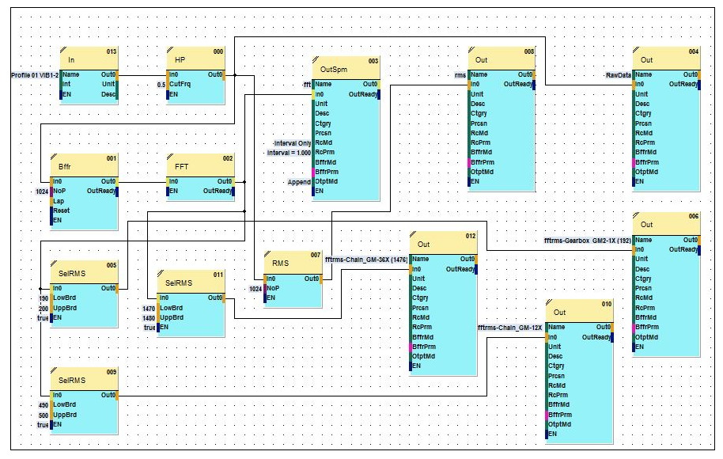
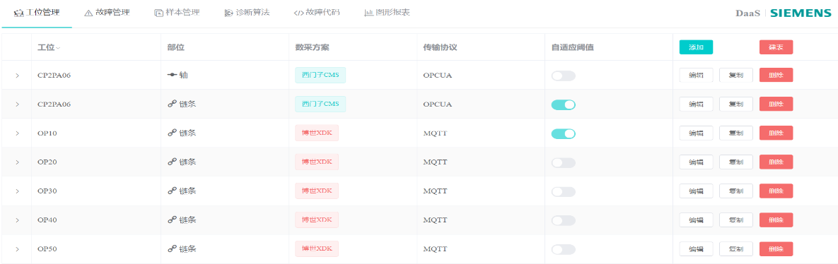
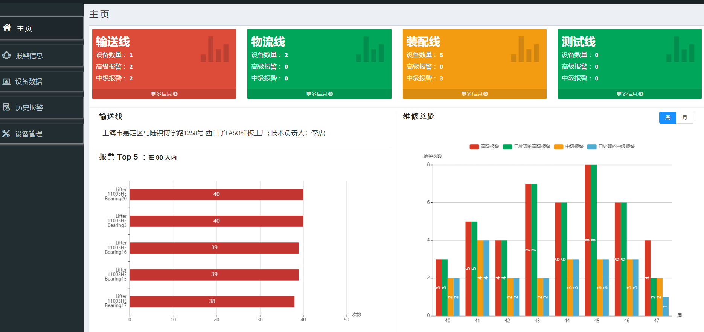
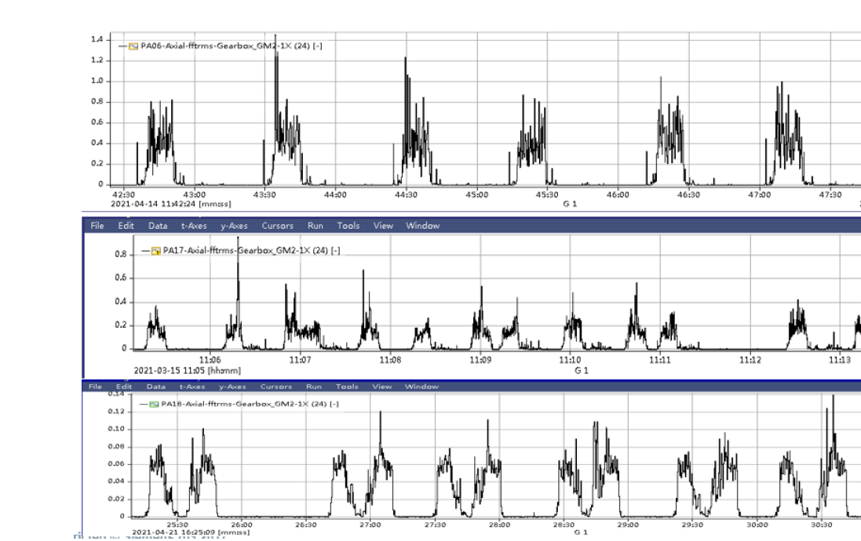
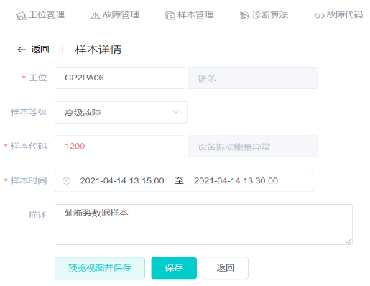
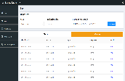



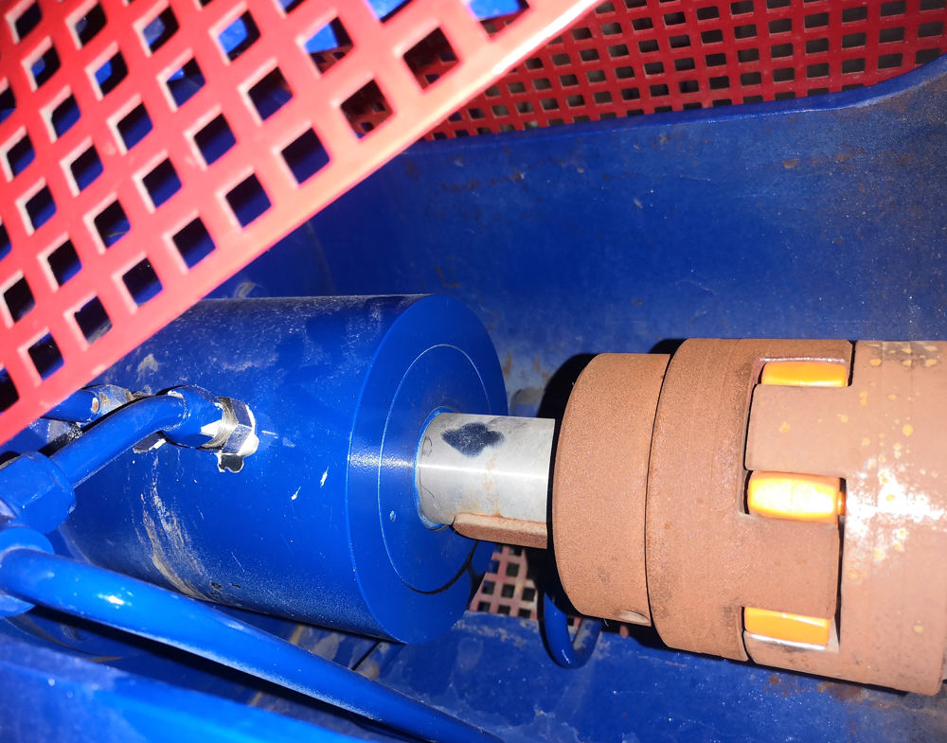
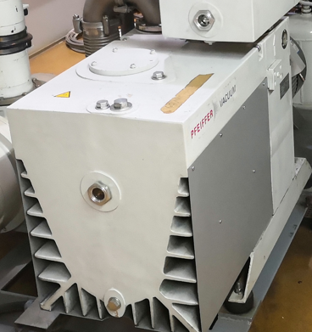
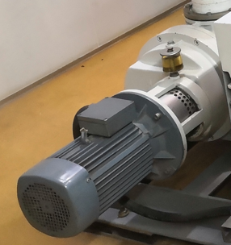
Solution of Vacuum Oven Pre-Maintenance （Phase I ） 真空炉预维护方案
Services/Apps
In Local Server
1*
Data Features Extraction
Data Models & Analysis
Maintenance App
Edge Data Collection
& Pre-processing
Domain know-how essential on all 3 layers
PLC：1215C
Sampling Cycle:1s
SM1281*1
for vibration
SM1231*1
for temperature
Field Level*
1 Vibration Sensor
1 Vibration Sensor
1 Temperature Sensor
2 Vibration Sensor
* Take one Vacuum Oven as example in the architecture
Restricted | © Siemens 2021 | T RDA IOT INW-CN
Notes:
Sensor Info：
PCB
Measuring Range：50g；Frequency Range：0.33~10000Hz；Protection Class：IP67；Price：3000 CNY

Slide 5
Work Scope of DAQ and Pre-processing 数采及数据处理工作
1- Test and Confirm the position of sensor installation
- Test the sensor data in the early stage and discuss the installation position.
- Guide sensors installation（not include the installation work).
2- Configure PLC and data acquisition module
- Field configuration to ensure real-time sensor data.
3- Data pre-processing by data acquisition module
- Review sensor data, define and ensure sensor baseline stable.
- Data pre-processing for sensors real-time data.
Restricted | © Siemens 2021 | T RDA IOT INW-CN
Notes:
Sensor Info：
PCB
Measuring Range：50g；Frequency Range：0.33~10000Hz；Protection Class：IP67；Price：3000 CNY

Slide 6
Work Scope of Data Feature Extraction 数据特征的提取工作
Data Features Extraction
1- X-tools setup and configuration
- Deploy X-tools .
- Configure the variable for on-site sensors.
2- Data feature calculation modules
- Build data feature calculation modules to extract the sensors data feature.
- Time-domain and Frequency-domain features calculation
- Take consideration to performance.
Restricted | © Siemens 2021 | T RDA IOT INW-CN
Notes:
Sensor Info：
PCB
Measuring Range：50g；Frequency Range：0.33~10000Hz；Protection Class：IP67；Price：3000 CNY

Slide 7
Work Scope of Data Storage & Analysis 数据存储和分析的工作
1- Create data models and store real-time data
- Create the device and component models.
- Access and store the real-time series data.
2- Calculate the initial threshold basd-on algorithms
- Define the initial threshold based on statistics algorithms.
- Realize event alarm model for devices by threshold initially.
3- Prepare the data sample collection module
- Build the suitable data sample Labeling module for vacuum oven data sample collection.
4- Integrate machine learning module
- Integrate machine learning algorithms.
- Help give the algorithms score by ML module.
- Integrate vacuum oven maintenance know-how, associated alarm codes and maintenance instructions.
Data Models & Analysis
Restricted | © Siemens 2021 | T RDA IOT INW-CN
Notes:
Sensor Info：
PCB
Measuring Range：50g；Frequency Range：0.33~10000Hz；Protection Class：IP67；Price：3000 CNY

Slide 8
Work Scope of Maintenance App 维护应用端的工作
Maintenance App
1- Display device （vacuum oven） alarm
- Display device alarms according to alarm priority.
- Support alarm query by time and device number.
- Save the history alarm record.
2- Device alarm statistics
- Statistic the device failure to support tracking of device bottlenecks.
- Convenient to track the device operation and production status.
- Check the maintenance KPI.
3- Provide maintenance guidance by domain know-how
- List the maintenance guidance for device alarm.
- Collect the on-site maintenance feedback.
Restricted | © Siemens 2021 | T RDA IOT INW-CN
Notes:
Sensor Info：
PCB
Measuring Range：50g；Frequency Range：0.33~10000Hz；Protection Class：IP67；Price：3000 CNY

Slide 9
Questions?
Answers!

Slide 10
Contact
Published by Siemens
T RDA IoT INW-CN
Expert
YU He
200, Linghu Avenue 214135, Wuxi China
Mobile: +86 18921506861
E-mail: yu-he@siemens.com

